Slide 1
Cultural Criticism

Slide 2
What is Cultural Criticism
This form of criticism examines how different religions, ethnicities, class identifications, political beliefs, and individual viewpoints affect the ways in which texts are created and interpreted. Cultural Criticism suggests that being a part of—or excluded from—a specific group or culture contributes to and affects our understanding of texts.

Slide 3
Four Common ideas in cultural criticism
Ethnicity, religious beliefs, sexual identity, and so on are crucial components in formulating plausible interpretations of text.
While the emphasis is on diversity of approach and subject matter, Cultural Criticism is not the only means of understanding ourselves and our art.
An examination or exploration of the relationship between dominant cultures and marginalized cultures is essential.
When looking at a text through the perspective of marginalized, or subordinate, peoples, new understandings emerge.

Slide 4
Practicing cultural criticism
What do you see in this picture

Slide 5
Practicing cultural criticism
How might someone view this picture through the lens of cultural criticism?
How do I think society would view this picture?
When I look at this picture I think____
My background as a __________ might lead me to this idea because________.
If I was the person in the picture (Bill Cosby), my thoughts would be _________.

Slide 6
Practicing cultural criticism
What do you see in this picture?

Slide 7
Practicing cultural criticism
How might someone view this picture through the lens of cultural criticism?
How do I think society would view this picture?
When I look at this picture I think____
My background as a __________ might lead me to this idea because________.
If I was the person in the picture (my thoughts would be _________.

Slide 8
Read “Speaking with hands” by Luis j. rodriguiz
As you read:
As you read the poem, underline words and phrases that convey the writer’s culture and the relationships between the people in the poem.
After you read:
Make a few remarks with cultural criticism in mind. Think about the person’s position in the story
How do I think society would view this poem?
When I read this poem I think____
My background as a __________ might lead me to this idea because________.
If I was the person in the poem, my thoughts would be _________.

Slide 9
Questions to ask for cultural Criticism
How do I think society would view this poem?
When I read this poem I think____
My background as a __________ might lead me to this idea because________.
If I was the person in the poem, my thoughts would be _________.

Slide 10
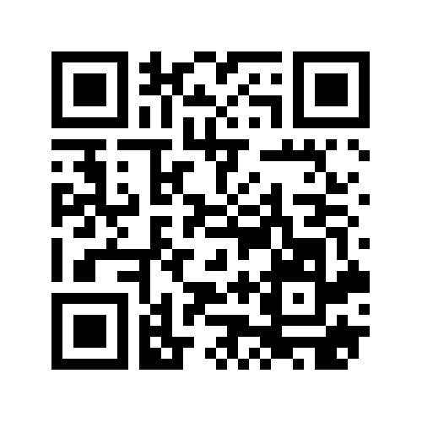
Add your criticisms Here
https://padlet.com/aliyyahss/criticisms

